Slide 1
Work Experience
Monday 6th-Friday 17th July
Monday 6th-Friday 17th July
WEX Dates: Monday 6th-Friday 17th July

Slide 2
Why Do Work Experience ?

Slide 3


Why Do Work Experience ?
Increases your motivation to study
Gives you clearer understanding between school and the outside world
Helps you to make informed choices about what profession you may like to explore after school
Find your why and your purpose

Slide 4
What is out there...LOTS
Important you talk to people you know
Speak to your parents/ carers/tutors
Think positively and excitedly about potential options
You get out what you put in

Slide 5

PREVIOUS YEARS PLACEMENTS
Formula 1/ Racetracks
West End Theatre
London Banking
Greece- Turtle Conservation
Army Residential
Engineering- Serco- Portsmouth
Bakers
Auto mechanics
Beauticians
Portsmouth Guildhall- Entertainment industry
Vets
Local newspaper/ radio

Slide 6


Work Experience Process
ONLINE
OWN PLACEMENT
You can ONLY CHOOSE 1 Pathway

Slide 7
Work Experience Process
Once your application has changed to
Employer Accepted
Or
Confirmed
YOU WILL NEED TO MAKE CONTACT WITH EMPLOYER !!!

Slide 8
Important Key Points to remember!
Can only apply up to 4 placements at a time
You have to be eager for all 4 choices, not just your first
Make sure you can get there - train, bus, taxi, walk
Make sure when searching, use correct post code
Check through Job Description before applying. Make sure you are happy with the hours, lunch breaks, clothes to wear. All key ingredients when searching and applying for jobs in the future.
You can work up to 40 hours a week and it will be unpaid

Slide 9
Key Points continued...
Employer must have Employers Liability Insurance or we cannot approve placement
Please make sure you only apply using one pathway. Either own placement form or online process. Please do not do both. If you chose online and then wish to change it once its confirmed, a deletion charge will incur
Phone for Interview as and when placement is Employer Accepted or Confirmed.

Slide 10
Login
Website: http://ebpsouth.work-experience.co.uk
Google: EBP south work experience login
Username: fullname (all lowercase no spaces)
Password: Wex123!
When changing password, you need to make sure you use a Capital Letter, lowercase letters, a Numeric & also a special character
(preferably ! Or # as students will relate to these more)
WEX Dates: 1st July-18th July 2024

Slide 11


Slide 12
Thank you for listening
Good Luck!

Slide 13
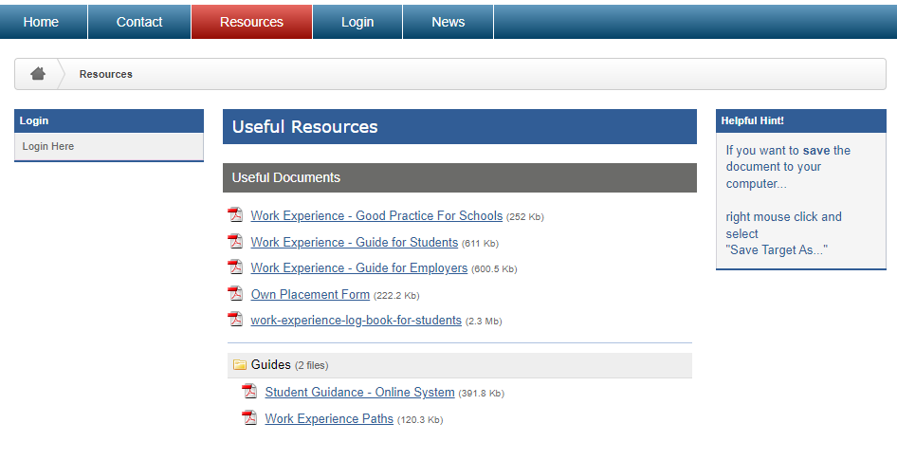

Resources
Work Experience Guidance Video
You can find the video on our website www.ebpsouth.co.uk

Slide 14
